Slide 1
A Video-Texture Based Approach for Realistic Avatars of Co-Located Users in Immersive Virtual Environments Using Low-Cost Hardware
Notes:
We are here to present the Paper A video texture based approach for realistic avatars.

Slide 2
Authors
Conference
Robin Horst,
Sebastian Alberternst,
Jan Sutter,
Philipp Slusallek,
Uwe Kloos,
Ralf Dörner
International Conference on Computer Graphics Theory and Applications
Year: 2019
Notes:
This are the authors of this paper presented in the international conference on computer graphics theory and applications in the 2019.

Slide 3
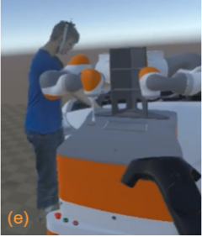
Problem:
Realism for interaction between users inside a virtual environment.
Collaboration
Accuracy
Body Language
Preventing effects such as Proteus Effect
Notes:
In applications that require collaboration is important to provide the multiple integrants of the task with all the body language that can help in real world.
In projects that require real world precission is important to avoid the proteus effect for example, where users adapts themselfs to the avatar.

Slide 4
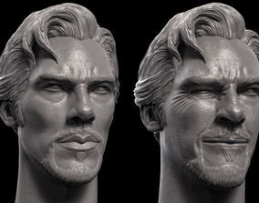
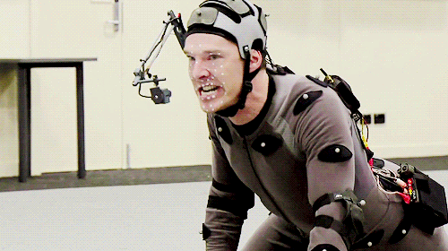
Actual Solutions
Highly realistic avatars.
Customization
Trackers & IA
Perspective information
Notes:
Other problem with this kind of scenarios is the requiriments to create highly realistic avatars. They require scanning people fo example, obtining all bones movement and realistic rendering techniques. this make them costly.

Slide 5
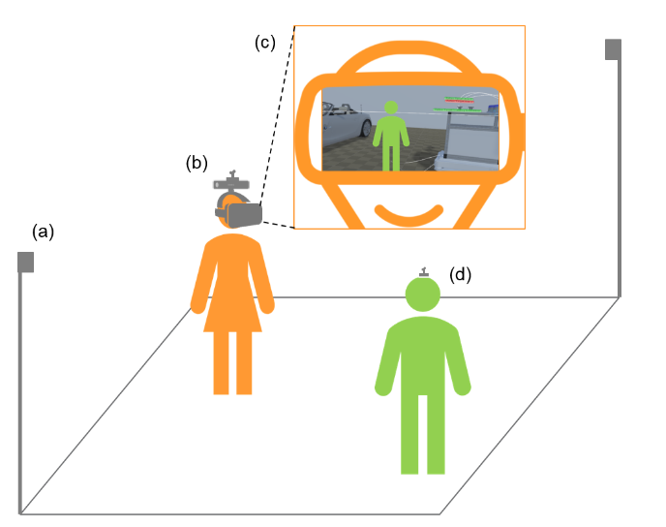
Paper’s solution
RGB capture from point of view
Add user in a 2D plane in the Virtual Environment
Notes:
The choosen approach for solving this challenge is to capture images of the users and project them inside the environment providing "visual realism".

Slide 6
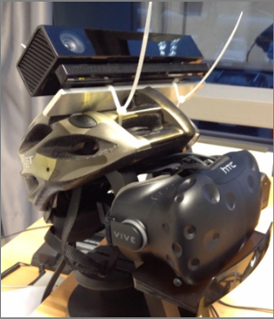
Paper’s solution
Low cost setup
Occlusion techniques
Image segmentation
Notes:
To archieve it they make use of a novel aproach for extracting the images from the real world with low cost system and some occlusion techniques to place them in a 2D plane in the scene.
They use a kinect v2, a VR set, a Vive tracker and a helmet rig.
With this elements, the cameras get the color, depth and view direction of the user.

Slide 7
Related Works
Other works explore similar approaches:
Realistic 3D models
Realistic tracking techniques
Depth information
Chroma Screens
Notes:
Is important to mention that other works approach this problem too. They're solutions make use of multiple cameras, multiple kineckt devices for depth information, realsitic models for avatars and so one. (Zhu et al., 2016), uses an aproaach really close to this one but it does not integrate a 2D plane for representing the extracted images in the enviorment.

Slide 8
LOW-COST VIDEO-TEXTURE APPROACH
Technical Setup
Capturing People
Situating People
User Study
Evaluation

Slide 9
LOW-COST VIDEO-TEXTURE: Technical Setup
Room with the size of the VR environment
tracker for immersed and co-located users
RGB and Depth sensors for immersed users
Notes:
This method is implemented in a room with the scale of the virtual enviorment to create a tracked area to place immersed and non-immersed users. Non-immersed users will only carry the traking device since they dont need to observe the virtual environment

Slide 10
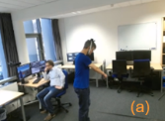
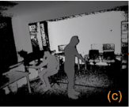
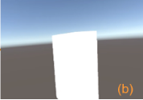
LOW-COST VIDEO-TEXTURE: Technical Setup
RGB
Depth
User position
User Prespective
Notes:
With this elements, the cameras get the color, depth and view direction.

Slide 11
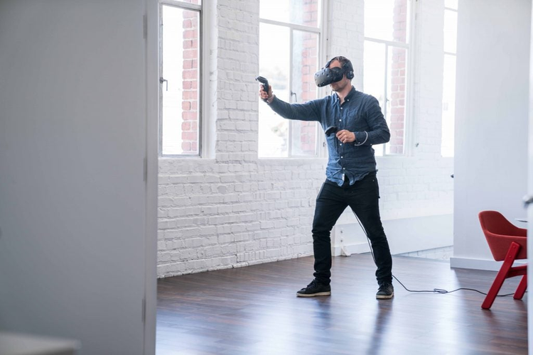
LOW-COST VIDEO-TEXTURE: Capturing People
BGRA image of size 1920x1080
Notes:
The first step to capture people from the point of view of the immersed user is done with the tracam (kinect). We get the color and depth information and also the location on the room of the co-located user.

Slide 12
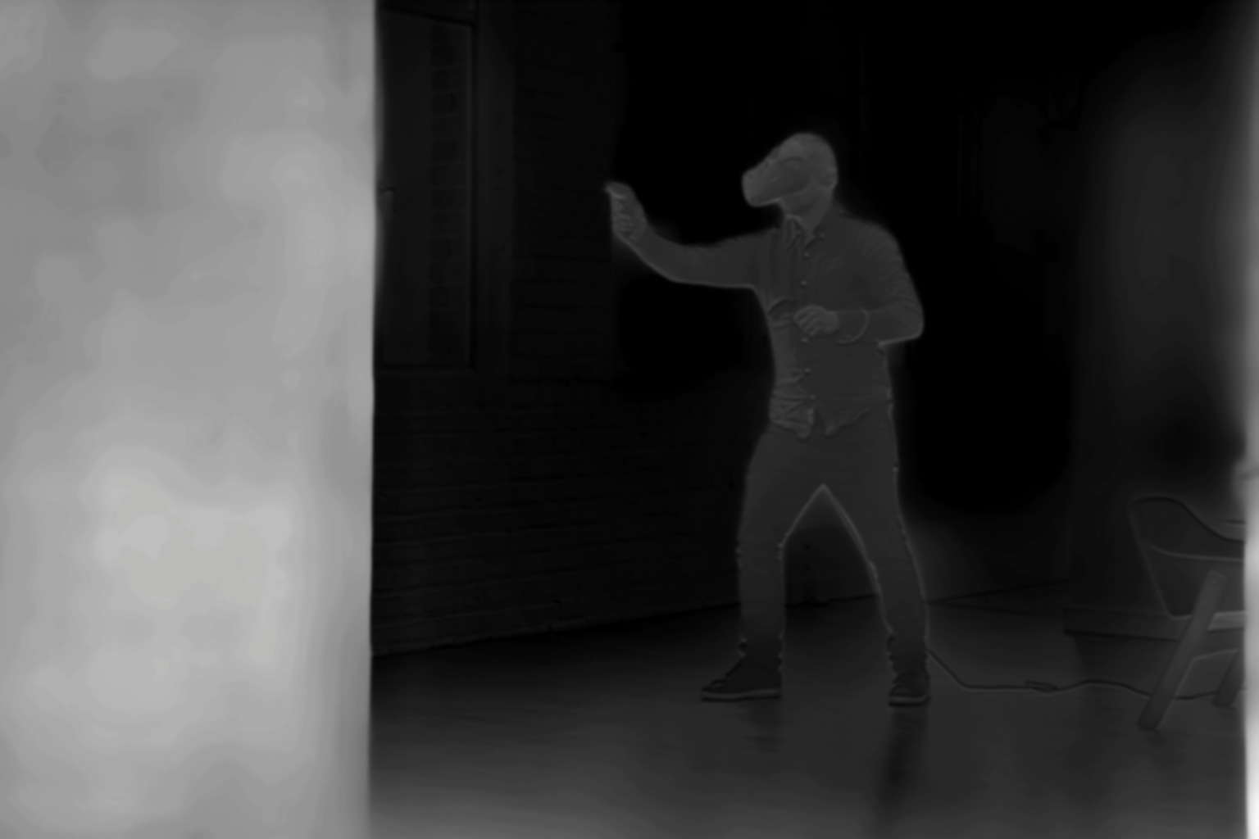
LOW-COST VIDEO-TEXTURE: Capturing People
Depth image of size 512x424
Notes:
The first step to capture people from the point of view of the immersed user is done with the tracam (kinect). We get the color and depth information and also the location on the room of the co-located user.

Slide 13
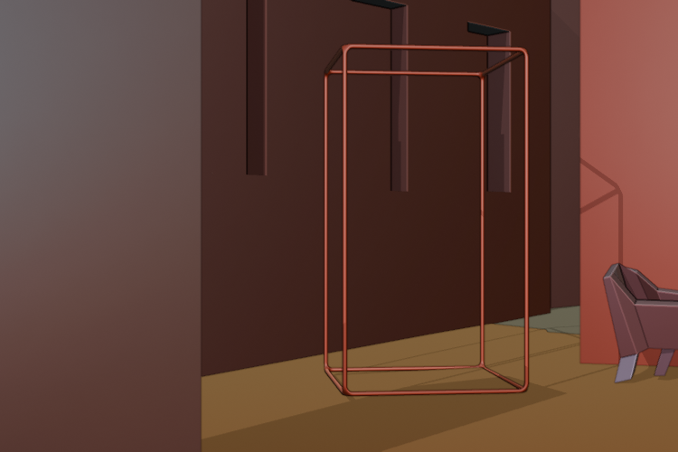
LOW-COST VIDEO-TEXTURE: Capturing People
Position of the user
Notes:
The first step to capture people from the point of view of the immersed user is done with the tracam (kinect). We get the color and depth information and also the location on the room of the co-located user.

Slide 14
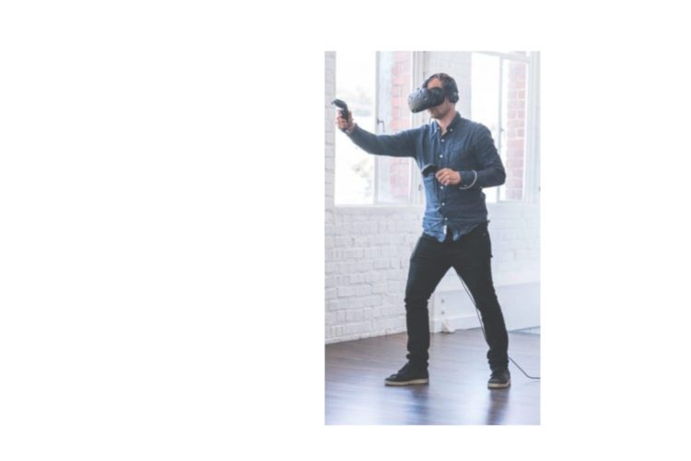
LOW-COST VIDEO-TEXTURE: Capturing People
Bounding Box as a mask
Notes:
The first step to capture people from the point of view of the immersed user is done with the tracam (kinect). We get the color and depth information and also the location on the room of the co-located user.

Slide 15
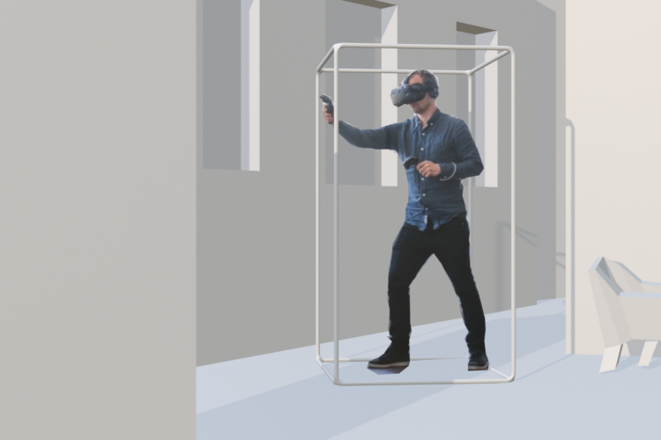
LOW-COST VIDEO-TEXTURE: Capturing People
Depth + bounding box position as mask
BXmin​≤X≤BXmax
BYmin​≤Y≤BYmax
BZmin​≤Z≤BZmax
Notes:
The first step to capture people from the point of view of the immersed user is done with the tracam (kinect). We get the color and depth information and also the location on the room of the co-located user.

Slide 16
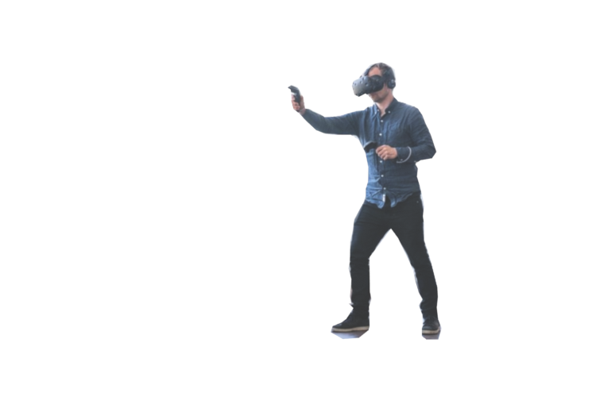
LOW-COST VIDEO-TEXTURE: Capturing People
Depth + bounding box position as mask
BXmin​≤X≤BXmax
BYmin​≤Y≤BYmax
BZmin​≤Z≤BZmax
Notes:
The first step to capture people from the point of view of the immersed user is done with the tracam (kinect). We get the color and depth information and also the location on the room of the co-located user.

Slide 17
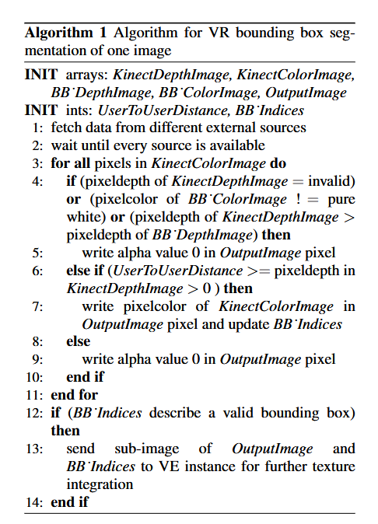
LOW-COST VIDEO-TEXTURE: Capturing People
Papers Pseducode:
Notes:
The first step to capture people from the point of view of the immersed user is done with the tracam (kinect). We get the color and depth information and also the location on the room of the co-located user.

Slide 18
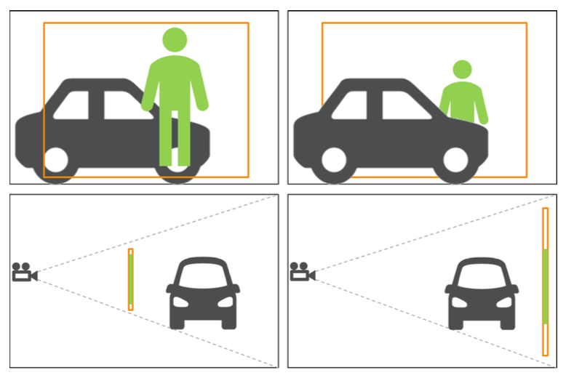
LOW-COST VIDEO-TEXTURE: Situating People
Video texture is drawn on a billboard
Distance to camera adjusted according to tracker data
Absolute size adjusted to compensate for distance

Slide 19
Occlusion handling
Mapping 3D data onto a 2D plane causes a loss of a dimension
In certain situations the co-located avatar should occlude virtual objects but doesn’t (with outreaching arms)
To compensate for this the virtual avatar is offset towards the virtual camera by 70cm, projecting it at roughly the edge of the bounding box

Slide 20
Evaluation: User test design
15 participants between the ages of 23 and 35
10 male, 5 female
Recruited from the university environment and engineering staff
Procedure:
Demographic questionnaire
Technical setup introduction
12 minutes of interaction with experimenter
Questionnaire with open ended questions

Slide 21
Evaluation: Findings
- Video texture avatars were useful and adequate
- Non verbal cues could be interpreted well at close distances
Issues:
- On some angles parts of the avatar were cut off due to bad coverage by kinect
- At larger distances the quality of the avatar diminished and it became harder to interpret
- The camera rig was uncomfortable
- Lighting of the avatar was highly unnatural

Slide 22
Conclusions by Authors
Low cost hardware solution
No dependence on pre trained computer vision
No prior 3D scanning
No texture baking
View independent rendering
Focus on co-located people

Slide 23
Our Conclusions
Hardware is being integrated into commercial headsets e.g. Quest 3
This solves the problem with clunky hat
Good use of limited resources for real time avatars
More work is required for integrating real life and virtual lighting
Could take clues from differential rendering
Dynamic lightning conditions on the VR world should affect the avatar
Real world lightning conditions have to be taken into account carefully adding complexity to the setup

